Slide 1
ASP.NET – Part III
State Management, Master Pages, User Controls, Web.config, Membership, IIS and Deployment
Branislav Abadjimarinov
MCT, MCTS, MCPD, MTS VMware
www.abadjimarinov.net

Slide 2
Table of Contents
State Management
Master Pages
User Controls
Web.config
Membership
IIS and Deployment

Slide 3
State management

Slide 4
State Management
What is state and why do we need to keep it
HTTP is stateless protocol
Ways to manage state
Client-based state management options
Server-based state management options
Usability
Performance
Scalability
Security

Slide 5
State management options
Cookies
Hidden fields
View state (and control state)
Query strings
Application state
Session state
Items collections
Profile properties

Slide 6

Cookies
Small amount of data used to keep state (the HTTP way)
Stored on the client
in a text file on the file system
in-memory in the browser session
Contains site-specific info
Sent along with the http requests and responses
Persistent cookies
Notes:
C:\Users\Black\AppData\Roaming\Microsoft\Windows\Cookies

Slide 7
Hidden fields
HTML tag
Not visible in the browser
Visible in the html source of the page
Acts as repository for page-specific info
Stores a single text value
Do not store security sensitive information in hidden fields

Slide 8
View astate
Dictionary object for keeping values between multiple requests for the same page
ViewState is property of System.Web.UI.Control
Default way to keep controls property values between requests
Values are hashed into a string
The string is added to a hidden field

Slide 9
View state
ASP.NET specific method
Automatic view state management
Can be controlled on different levels
Web.config level
@Page directive level
Contol level
View state persistence in extensibility point in asp.net

Slide 10
Control state
Store control-state data in order for a control to work properly
Works the same way as view state
Cannot be turned off

Slide 11
Query strings
Parameters passed as part of the url
Key value pairs
Separated by "&" sign
The query string starts after the "?" sign
Can be easily changed by the user
HttpUtilty.UrlEncode, HttpUtilty.UrlDecode
http://test.net/list.aspx?listid=61
string listID = Request.QueryString["listid"];

Slide 12
Application state
Dictionary for keeping information
Persisted on the server
One dictionary per application
The same for all users
Require synchronized access
Application.Lock();
Application["LoggedInUsers"] =
(int) Application["LoggedInUsers"] + 1;
Application.UnLock();

Slide 13
Session state
Dictionary for keeping information
Persisted on the server
By default in memory
Different for every user
Has a unique SessionID
Created at the first request
Persisted in a cookie by default

Slide 14
Session state
HttpSession class
Session property of Page and HttpContext
Session persistence modes
In Process
Out of process
SQL Server
Distributed engines
Session["OutstandingAmmount"] = 22400;
int outstandingAmmount =
(int) Session["OutstandingAmmount"] ?? 0;

Slide 15
Items Collections
Dictionary collection
Keeps information for one page lifecycle
Accessed using Context.Items
Used to transfer information between controls in the same request
Great for per request caching

Slide 16
Master Pages

Slide 17
Master Pages
Master pages keep reusable html over multiple pages (for example header, footer, menus, etc.)
Has content areas marked with ContentPlaceHolder control
Only development time abstraction
Upon request the master page content and the page content are merged in single html

Slide 18
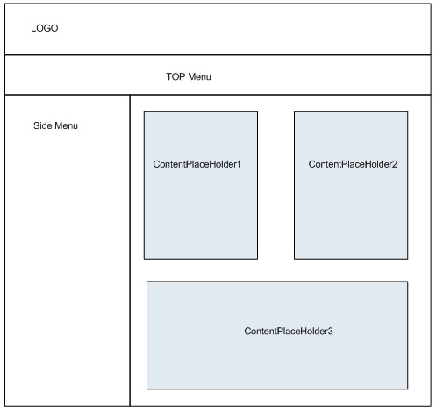
Master Pages

Slide 19
Master Pages
Can be nested
Can be changed programmatically
Has a @MasterPage directive at the top
Strongly-typed access to master page

Slide 20
User Controls

Slide 21
User Controls
Unites content into a single reusable control
A file with .ascx extension
Has code behind (.ascx.cs)
Has @Control directive at the top
Deployed with Xcopy
Can be accessed programmatically
In order to be used on a page the control has to be registered with @Register directive

Slide 22
Web.config

Slide 23
Configuration
XML based files with .config extension
Levels of configuration
Machine.config
Application's root folder web.config
Subdirectory web.config
Directives (@Page, @Control, @MasterPage)
Controls
If you change .config file the worker process is restarted (all in process data is lost)

Slide 24
Membership

Slide 25
Basics
Authentication
The process of verifying the identity of a user or computer
Authorization
The process that determines what a user is permitted to do on a computer system or network

Slide 26
Authentication Types
Windows Authentication
Uses the security features integrated into the Windows NT / Windows XP operating systems
Forms authentication
Code associated with a Web form handles users authentication
Users list is stored and used by the form

Slide 27
Windows Authentication
Web application use the same security scheme that applies to your network
Network resources and Web applications use the same:
User names
Passwords
Permissions

Slide 28
Windows Authentication (2)
The user is authenticated against his username and password in the OS
When a user is authorized:
ASP.NET issues an authorization certificate (a cookie)
Application executes using the permissions found in your account
The user's session ends when the browser closes or when the session times out

Slide 29
Windows Authentication (3)
Users who are logged on to the network
Are automatically authenticated
Can access the Web application
To set the authentication to Windows add to the Web.config
To deny anonymous users add
<authentication mode="Windows" />
<authorization>
<deny users="?"/>
</authorization>

Slide 30
Forms Authentication
Displays Web form to collect user name and password information
Users are authenticated by the code associated with the Web form
Users list is stored in the application's:
Web.config file
Separate user database
The user don't have to be member of the network

Slide 31
Roles
The actions and activities that are
Assigned
Expected
Required
to a person or group
The roles usually determine the level of access of the user account
A user account can be assigned with multiple roles
Permissions can be granted to multiple users sharing the same role

Slide 32
Security Providers
Membership provider
Helps to simplify common authentication tasks
CreateUser
DeleteUser
GeneratePassword
ValidateUser

Slide 33
Security Providers (2)
Role providers
Helps to simplify common authorization tasks
CreateRole
IsUserInRole
GetAllRoles
GetRolesForUser

Slide 34
Membership provider
Adding membership provider to the Web.config
<membership defaultProvider="MyProvider">
<providers>
<add connectionStringName="MyConection"
minRequiredPasswordLength="6"
requiresQuestionAndAnswer="true"
enablePasswordRetrieval="false"
requiresUniqueEmail="false"
applicationName="/MyApp"
minRequiredNonalphanumericCharacters="1"
name="MyProvider"
type="System.Web.Security.SqlMembershipProvider"/>
</providers>
</membership>

Slide 35
Enabling Roles
To enable roles in ASP.NET 2.0 add to the Web.config file:
We also add role provider to manage the roles
<roleManager enabled="true" defaultProvider="MyProvider">
<providers>
<add connectionStringName="MyConection"
name="MyProvider"
type="System.Web.Security.SqlRoleProvider" />
</providers>
</roleManager>

Slide 36
aspnet_regsql.exe
The ASP.NET SQL Server Registration tool is used to create a Microsoft SQL Server database for use by the SQL Server providers in ASP.NET
The aspnet_regsql.exe utility that is installed with ASP.NET 2.0 is in:
C:\WINDOWS\Microsoft.NET\Framework\ v2.0.50727\aspnet_regsql.exe

Slide 37
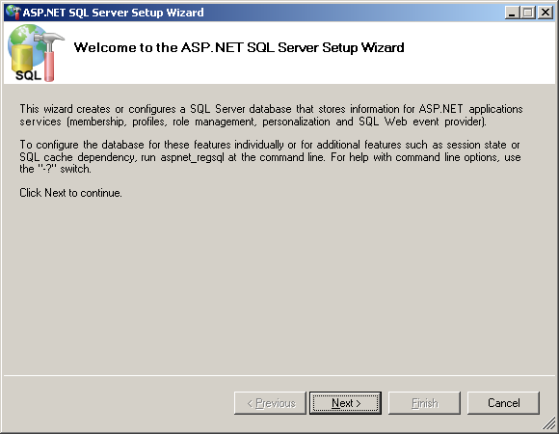
aspnet_regsql.exe – Live Demo

Slide 38
ASP.NET Web Site Administration Tool
Designed to manage your Web site configuration
Simple interface
Can create and manage users, roles and providers
Can manage application configuration settings
Accessible through Website menu → ASP.Net Configuration

Slide 39
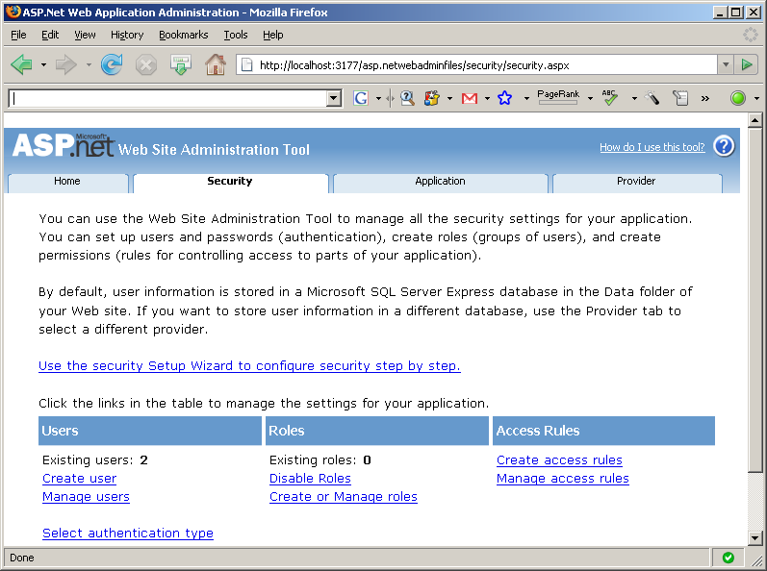
Administration Tool – Live Demo

Slide 40
Login controls
Configure Membership Provider and database and they just work
Login
Login Name
Login Status
Login View
Create User Wizard
Change Password
Password Recovery

Slide 41
IIS and Deployment

Slide 42
IIS
IIS – Internet Information Services
Set of windows services used to host web applications
Free with Windows OS
IIS 5 (Windows XP)
IIS 6 (Windows Server 2003 and Windows XP Professional x64 Edition)
IIS 7 (Windows Vista and Windows Server 2008)
IIS 7.5 (Windows 7 & Windows Server 2008 R2)

Slide 43
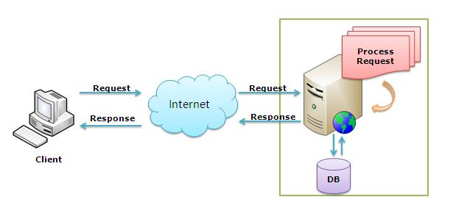
IIS
Hosts ASP.NET applications
Has its own ASP.NET processing engine
Takes a request, process it and returns the response

Slide 44
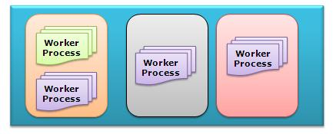
IIS Request Processing
HTTP.sys kernel mode driver
Aspnet_isapi extension
Worker process (w3wp)
Application pools
Classic pipeline
Integrated pipeline
Http Modules and handlers
Page lifecycle

Slide 45
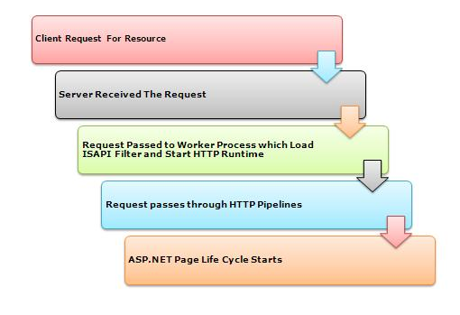
IIS Request Processing

Slide 46
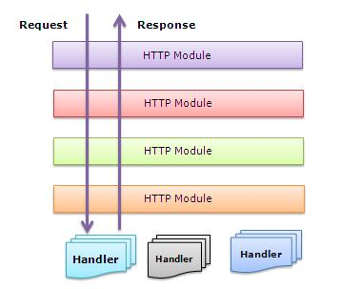
HTTP Pipeline
Http modules
Have access to incoming requests
Can filter or change requests
Multiple modules executed per request
Http handlers
Generates the response
Only one per request

Slide 47
Website configuration
Website root directory (C:\inetpub\wwwroot\..)
File system security
Create site in iis management console
Choose hostname
Choose the .net framework version
Choose the application pool pipeline mode
Add website address in hosts file (C:\Windows\System32\drivers\etc\hosts)
Additional configuration

Slide 48
ASP.NET – Part III

Slide 49




Useful sites
www.asp.net
www.stackoverflow.com
www.iis.net
www.abadjimarinov.net/blog

